Slide 1

A VISION
TO REIMAGINE
SUPPLY CHAIN
Team Name: IRON_HEART
Team Members: Saiteja Korada, Mohini Swami, N Yogeesh
Institute Name: IIFT DELHI

Slide 2


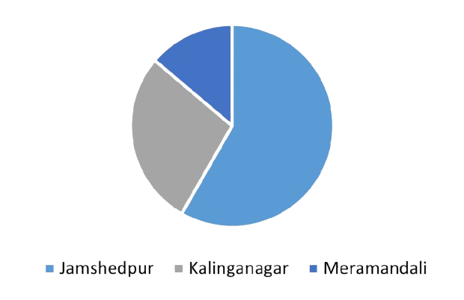
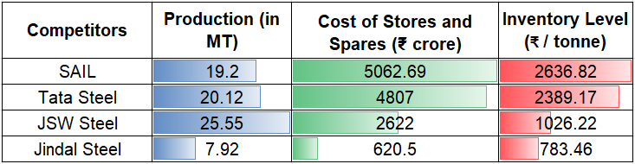


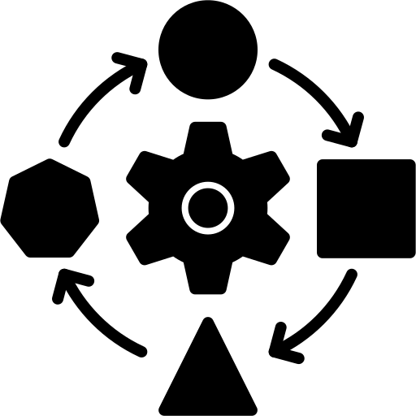


PROBLEM STATEMENT
DATA ANALYSIS
VENDOR CAPABILITIES
SOLUTION
IMPLEMENTATION
RISK &
MITIGATION PLAN
COST-BENEFIT ANALYSIS
Orders by Location
CHALLENGES
DATA OVERVIEW
14%
High overall inventory level
4967
~36.86
58%
28%
SKUs ordered
Million units ordered
Analysis & Analytics
Capability Realizations
Implementation of VMI & its Benefits
Data is taken from annual reports, comparison may not be like to like based on financial treatment
SOLUTION OVERVIEW
2% cases of stockouts especially during unplanned requirements such as breakdown
Complexity in the transfer of inventory from one location to another:
On an average 2 instances of stock transfer per month
POTENTIAL ROOT CAUSES
Lack of centralized inventory management
Lack of suitable inventory classification
Non-uniform Demand
Incorrect safety stock levels
Managing MRO inventories in silos is posing challenges of high overall inventory, stockouts and complexity in stock transfers. Its an immediate requirement to go for a centralized inventory models such as VMI

Slide 3
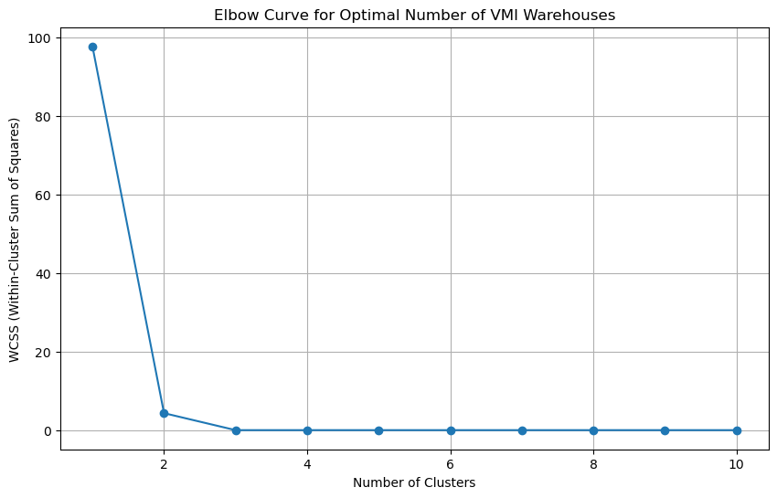
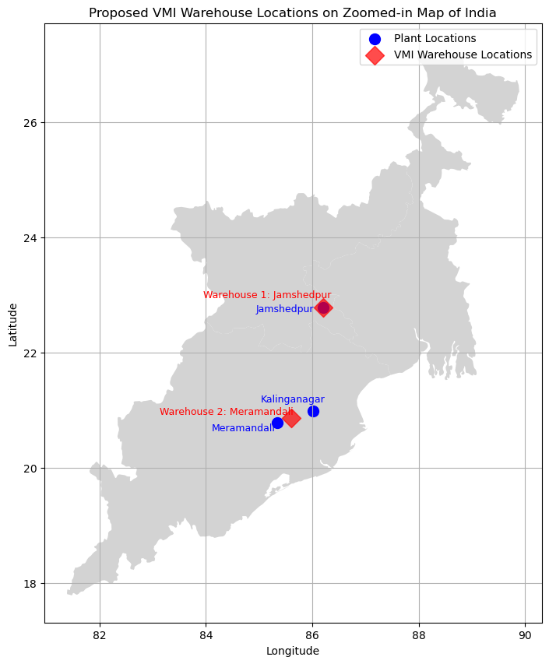


PROBLEM STATEMENT
DATA ANALYSIS
VENDOR CAPABILITIES
COST-BENEFIT ANALYSIS
SOLUTION
IMPLEMENTATION
RISK &
MITIGATION PLAN
ANALYSIS FOR NUMBER OF WAREHOUSES
WAREHOUSE LOCATION ANALYSIS
Factors considered : variability in the demand, volumes, and distances between the facilities.
Factors Considered : Proximity to the plant locations and Demand Volume proportions
Sharp Drop at First
Lower WCSS after 2 clusters
Geospatial analysis suggests two optimal VMI store locations: Jamshedpur (22.78801; 86.19805) and Dhenkanal (20.693640, 85.571158)
Optimal number of warehouses are 2 and the optimal locations to establish the warehouses are Jamshedpur and Dhenkenal

Slide 4
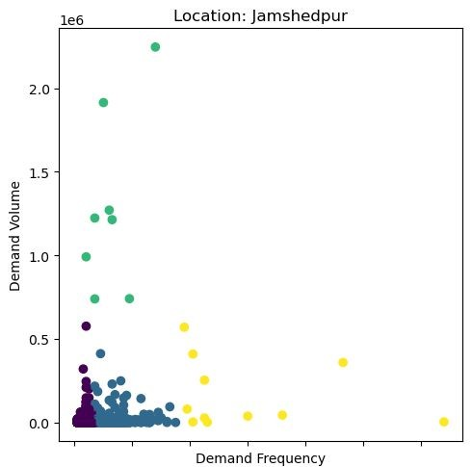
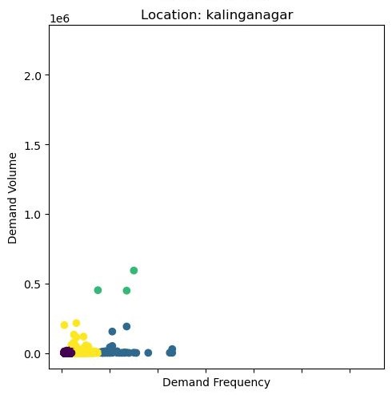
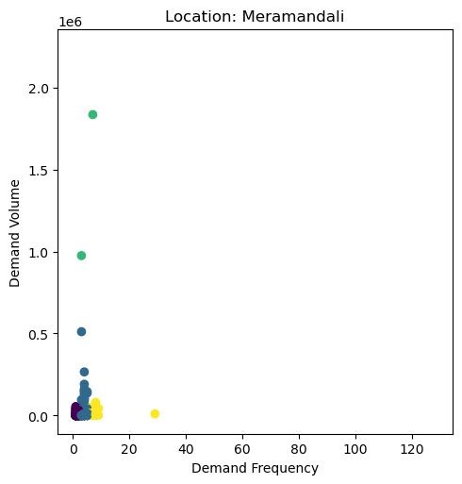

PROBLEM STATEMENT
DATA ANALYSIS
VENDOR CAPABILITIES
COST-BENEFIT ANALYSIS
SOLUTION
IMPLEMENTATION
RISK &
MITIGATION PLAN
CLUSTERS OF SKU’S LOCATION WISE
STORE WISE ALLOCATION PROPOSAL
 | JAMSHEDPUR | KALINGA NAGAR | MERAMANDALI
LOCAL STORAGE (JAMSHEDPUR)
LOCAL STORAGE (KALINGANAGAR)
LOCAL STORAGE (MERAMANDALI)
VMI STORE AT JAMSHEDPUR
VMI STORE AT DHENKANAL
JIT MODEL
ALLOCATION STRATEGY
JAMSHEDPUR
KALINGANAGAR
MERAMANDALI
High Frequency-Low Volume : Local Store
11
3
89
Low Frequency-High Volume : VMI Store
449
35
2
Mid Frequency-Mid Volume: VMI Store
7
350
499
Low Frequency-Low Volume: JIT model
2747
1422
782
Assumption: The categorization and strategy doesn’t consider the criticality of the SKU
4 Categories of SKUs can be allocated to 5 (3 LS and 2 VMI) warehouses

Slide 5
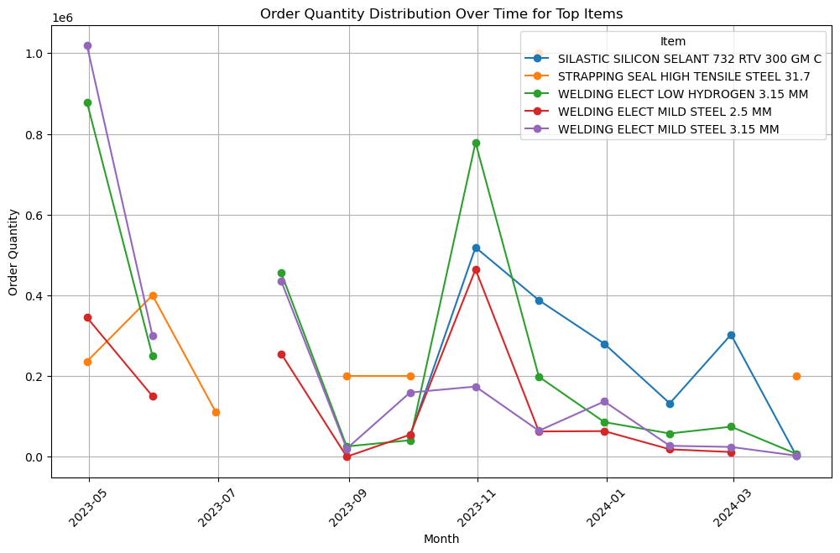
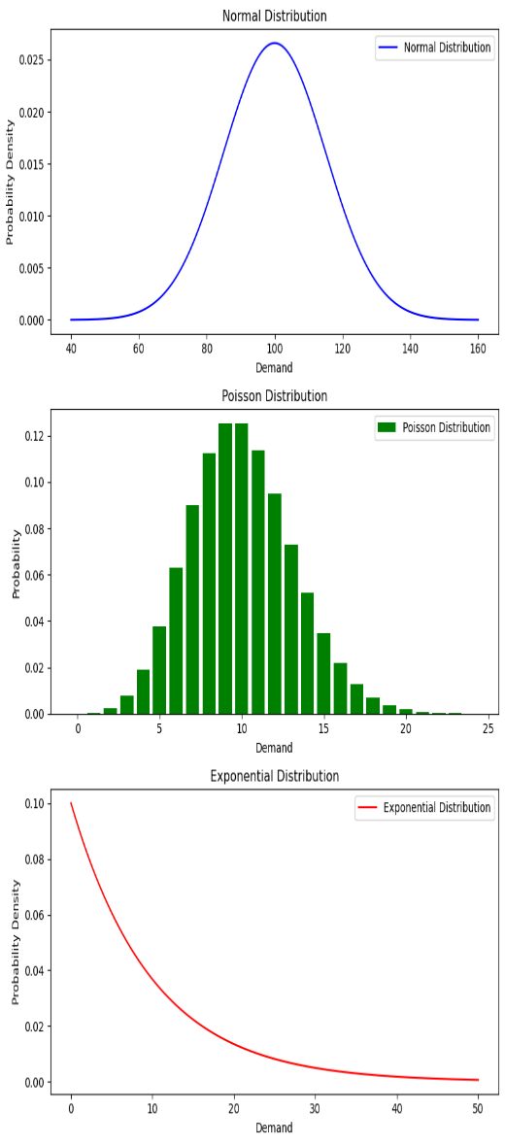

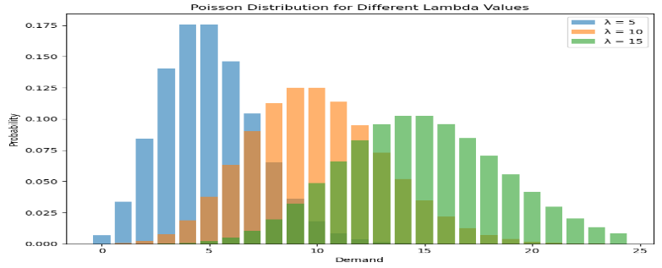
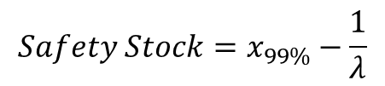


PROBLEM STATEMENT
DATA ANALYSIS
VENDOR CAPABILITIES
COST-BENEFIT ANALYSIS
SOLUTION
IMPLEMENTATION
RISK &
MITIGATION PLAN
Demand Variation Analysis for top ordered items
High Initial Demand with Rapid Decline
Consistent Demand Patterns
Spike in Demand in Specific Months
Low Demand Periods
Strategic Inventory Management Needed
Demand Forecasting: Sophisticated demand forecasting methods to account for spikes & declines
Inventory Optimization: Optimize inventory levels to keep adequate safety stocks.
Understanding Drivers: Analyse the operational or production drivers for the high demand in specific months
Insights
Recommendations
Assumptions for Safety Stock: Lead time is assumed to be an average of 14 days, Service levels: 99%, ⁠⁠Demand Variability as per SKU
Normal Distribution
Exponential Distribution
Poisson Distribution
$safety stock=Z ∗ σ$d * $\sqrt{L}$
$$Safety Stock=x_{99\%}−\frac{1}{λ}$$
$$Safety Stock=x_{99\%}−λ . L$$
SAFETY STOCK ANALYSIS
Estimation of consumption of indirect materials like MRO is very difficult compared to direct materials in turn Safety Stock Calculations are highly complex and challenging due to uncertainty in demand. Need for deep analytical modelling

Slide 6




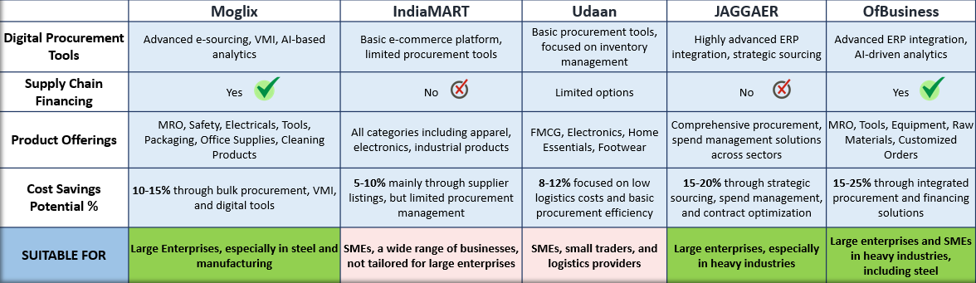
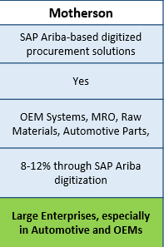

PROBLEM STATEMENT
DATA ANALYSIS
VENDOR CAPABILITIES
COST-BENEFIT ANALYSIS
SOLUTION
IMPLEMENTATION
RISK &
MITIGATION PLAN
REQUIRED VENDOR CAPABILITIES
B2B Marketplaces/Aggregators
AI-Enabled demand forecasting
Analytics-driven insights
Capability of operating a JIT, VMI model
SELECTING THE TMCC VENDOR
Moving forward with Moglix as the most suitable vendor for the TMCC. Subsequently, the onboarding of other appropriate vendors will follow to further enhance procurement capabilities.

Slide 7
PROBLEM STATEMENT
DATA ANALYSIS
VENDOR CAPABILITIES
COST-BENEFIT ANALYSIS
SOLUTION
IMPLEMENTATION
RISK &
MITIGATION PLAN
COST-BENEFIT ANALYSIS
Given expenditure: 4500 Cr
Estimated range:
4860-4950 crore
PAAS
(Procurement as a Service)
Projected to 2030: 40 MTPA
Gradual Ramp-up for 2024: 8-10%
Provide Moglix with constant visibility into our inventory, allowing it to replenish stock as it approaches the limit (Safety stock + EDDLT) for your whole indirect procurement.
Leverage Moglix's capability to break bulk orders, enabling us to order minimal quantities as needed.
Enabling a transparent process from procurement and quality inspections to reverse logistics leveraging scalability.
Offering customizable ERP solutions tailored to budget, ranging from SAP and Ariba to SCM systems for end-to-end operations.
Stringent delivery operations based on quantity, utilizing various modes of transport.
Utilize accurate demand forecasting to meet needs efficiently, simplifying warehouse management.
S/No | Cost Components | Projected Costs (INR Crore) | Projected Savings (INR Crore) | Net Benefit YEAR 1 | Net Benefit YEAR 2
1 | Warehouse Installation for Two Locations (CapEx) | 100 | 0 | -100 | -
2 | Technology Integration & Digital Transformation (CapEx) | 35 | 0 | -35 | -
3 | Operational Costs for VMI and JIT Management (OpEx) | 20 | 15 | -5 | -6.7​
4 | Moglix Service Charges (OpEx) - Existing SKUs | 18 | 30 | 12 | 10.8​
5 | Moglix Service Charges (OpEx) - New SKUs | 12 | 15 | 3 | 2.1​
6 | Projected Additional Costs for Capacity Increase (OpEx)* | 30 | 18 | -12 | -14.64​
7 | Transportation Costs (OpEx) | -20 | 20 | 40 | 20.4​
8 | Vendor Consolidation and Supplier Management | -10 | 10 | 20 | 10.2​
9 | Product Price Decrease due to Procurement Optimization | -15 | 15 | 30 | 15.3​
10 | Inventory Cost Reduction due to VMI | -18 | 18 | 36 | 18.36​
11 | Value-Added Services by Moglix (e.g., Supply Chain Financing) | -8 | 8 | 16 | 8.16​
 | Total Cost of Implementation | 144 | 149 | 5 | 63.98
*additional costs for capacity handling and managing new SKUs.
Percentage Savings (%)
~3%
~44%
A cost-benefit analysis of partnering with Moglix and leveraging its AI capabilities, highlighting its 44% cost savings potential

Slide 8
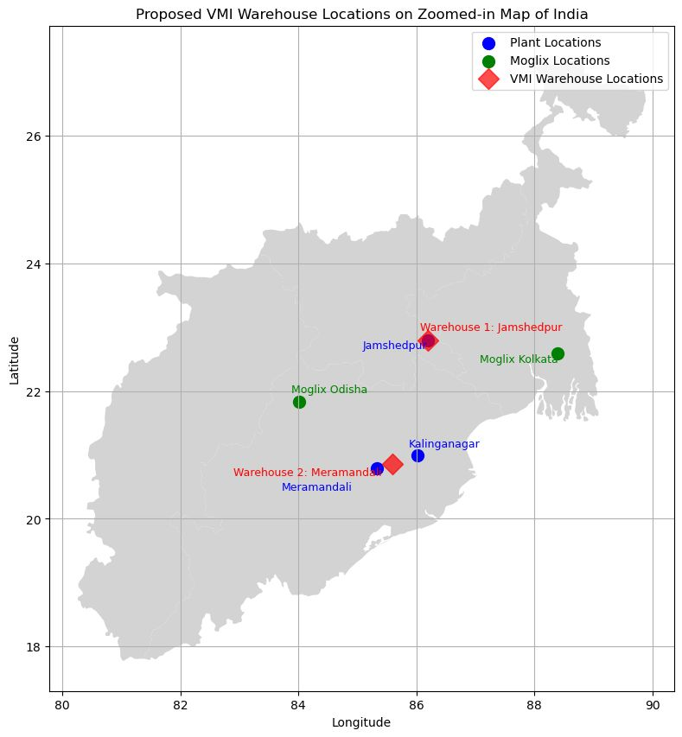




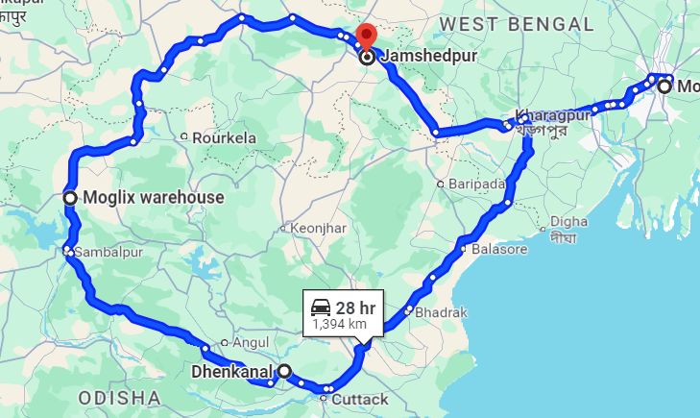
PROBLEM STATEMENT
DATA ANALYSIS
VENDOR CAPABILITIES
COST-BENEFIT ANALYSIS
SOLUTION
IMPLEMENTATION
RISK &
MITIGATION PLAN
MOGLIX WAREHOUSE LOCATIONS
SCOPE OF RESPONSIBILITY
JAMSHEDPUR
MERAMANDALI
KALINGA NAGAR
Procurement
Inventory
Procurement
Inventory
Procurement
Inventory
Existing
local
storage
High Frequency - Low Volume
Mid Frequency - Mid Volume
1
2
2
Low Frequency - High Volume
1
2
2
New VMI Stores
Low Frequency - Low Volume
IMPLEMENTATION TIMELINES
Aggregator’s responsibility
2024
2025
2026
2027
GOOGLE MAP VIEW
Full-Scale AI-enabled VMI Implementation
Aggregators Consolidation
Motherson & OfBusiness onboarding & Integration
Adaptation to AI-enabled procurement
Reviews & Enhancement
Leveraging both the existing Moglix warehouses and the proposed locations for VMI stores, the maximum lead time can be ~14 hours
Data visibility & Platform Integration
Shifting of SKUs
Moglix Onboarding

Slide 9




DATA ANALYSIS
VENDOR CAPABILITIES
SOLUTION
IMPLEMENTATION
RISK &
MITIGATION PLAN
PROBLEM STATEMENT
COST-BENEFIT ANALYSIS
RISK & MITIGATION PLAN
CONTRACT T&C
Dedicated quality engineer
Strict quality standard
agreements
Penalties
Inventory Monitoring and Replenishment
Qualified supplier certificates
Reaffirming suppliers' status as trusted partners
Ensure continuous monitoring of inventory levels at Tata Steel’s sites
Quality Compliance
Spurious products
Resistance of Suppliers
All materials delivered must strictly adhere to Tata Steel’s quality standards
Inventory Reporting
Should provide regular and detailed inventory reports to Tata Steel
Procurement Policy Compliance
Impact on local suppliers
Lack of data transparency
Adhere to Tata Steel’s procurement policies and ensure that all its suppliers comply.
Prioritization of Tata Steel's existing suppliers.
Clearance certificate for onboarding of New suppliers
Real-time data-sharing platform
Data security and binding agreements
Reverse Logistics and Returns Flexibility
Include provisions for flexibility in managing reverse logistics.
Price Deduction for Defective Products
If any spurious products are delivered to Tata Steel, a price deduction will be applied
All critical Risks which are identified should be mitigated by proposing suitable Terms and Conditions in the Contract
Non-Compete Clause for VMI Warehousing
Implement a non-compete clause for the VMI warehouse

Slide 10

THANK YOU!!

Slide 11
ANNEXURES
Google Drive Link for backend code and excel sheets:
https://drive.google.com/drive/folders/16z76LMMhdQvUbJfZZWxDLhRg_tZVND7-?usp=sharing
Tata Steel Integrated Report and Annual Accounts 2023-24
World Steel Association Data
Jindal Steel Integrated Annual Report FY 2023-24
JSW Annual Report
SAIL Annual Report 2023-24
TATA STEEL KALINGANAGAR STEEL PLANT
Inside Tata Steel India
SteelMint & CoalMint
Moglix-Website
Indiamart
Jaggaer
Ofbusiness
Udaan

